Slide 1
MINI-PROJECT
PROJECT TITLE :
Hand-Written Digit Recognition Using Deep Learning
Presented By: Under the Guidance of:
Rashmi A R Ms.Urooj
STB03-T0026 Trainer

Slide 2
Objective:
The objective of the Handwritten Digit Recognition Project is to create a robust Convolutional Neural Network (CNN) capable of accurately identifying and classifying handwritten digits. Utilizing the MNIST dataset, the project aims to achieve high accuracy. The focus is on designing a model that can handle diverse writing styles and contribute to advancements in image recognition.

Slide 3
Dataset Used:
MNIST Dataset
Samples provided from MNIST (Modified National Institute of Standards and Technology) dataset includes handwritten digits total of 70,000 images consisting of 60,000 examples in training set and 10,000 examples in testing set, both with labeled images from 10 digits (0 to 9).
Handwritten digits are images in the form of 28*28 gray scale intensities of images representing an image along with the first column to be a label (0 to 9) for every image.

Slide 4
The features of the dataset are as follows:
Pixels are arranged row-wise, ranging from 0 to 255, as from RGB color code.
Background as white (0 value from RGB) and foreground as black (255 value from RGB).
Labels of digits classified from 0 to 9.
There are four files of training and testing are:
Training set images files
Training set labels file
Test set images files
Test set label files

Slide 5
Tech Stack Used
Python:
Python serves as the primary programming language, providing a versatile and rich ecosystem of libraries for data manipulation, model development, and evaluation in the Handwritten Digit Recognition Project.
Deep Learning (CNN):
Convolutional Neural Networks (CNNs) form the core of the project's model architecture. CNNs are designed to automatically and adaptively learn spatial hierarchies of features, making them effective for image recognition tasks like handwritten digit classification.

Slide 6
TensorFlow and Keras:
TensorFlow is employed as the backend for Keras, facilitating efficient computation and optimization of neural networks. Keras, a high-level neural networks API, simplifies model construction, training, and evaluation, enhancing the development workflow in the Handwritten Digit Recognition Project.
Computer Vision:
Computer vision techniques are utilized to preprocess and manipulate the image data. This includes resizing images to a standard format, normalization, and potentially applying data augmentation methods to enhance the model's ability to generalize to various writing styles in the context of handwritten digit recognition.

Slide 7
Problems with handwritten digits
The handwritten digits are not always of the same size, width, orientation and justified to margins as they differ from writing of person to person, so the general problem would be while classifying the digits due to the similarity between digits such as 1 and 7, 5 and 6, 3 and 8, 2 and 5, 2 and 7, etc. This problem is faced more when many people write a single digit with a variety of different handwritings. Lastly, the uniqueness and variety in the handwriting of different individuals also influence the formation and appearance of the digits. To solve the above mentioned problems, we introduce the concepts and algorithms of deep learning and machine learning.

Slide 8
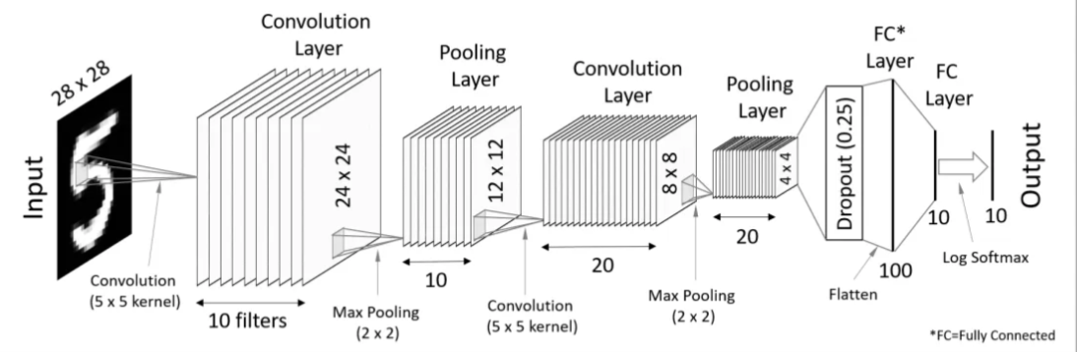
CNN Architecture in MNIST Dataset

Slide 9
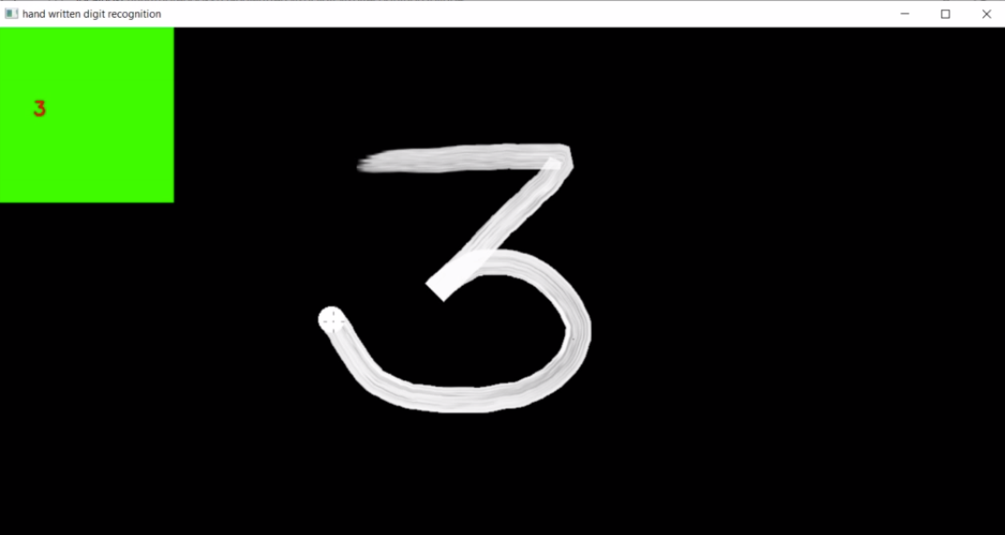
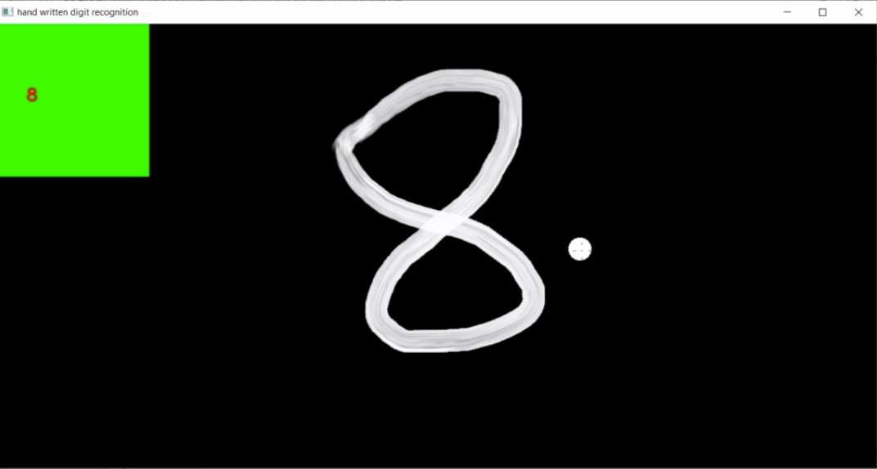
Output:

Slide 10
Conclusion
In conclusion, the Handwritten Digit Recognition Project demonstrates the power of Python, leveraging its extensive ecosystem for data science and machine learning. The project's core, a Convolutional Neural Network (CNN), showcases the effectiveness of deep learning in accurately classifying handwritten digits. The seamless integration of TensorFlow as the backend for Keras simplifies the model development process. Through the application of computer vision techniques, the project not only achieves high accuracy in recognizing diverse handwritten styles but also underscores the broader potential of machine learning in automating tasks such as optical character recognition. This project stands as a testament to the synergy of Python, deep learning, TensorFlow, Keras, and computer vision in solving real-world image recognition challenges.

Slide 11
Thank You

